Slide 1
USABILITY
Group Number: 9

Slide 2
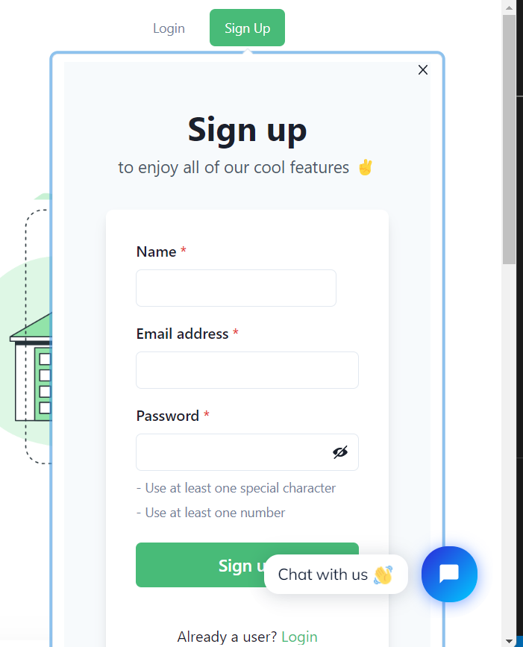
ERROR PREVENTION
- Users can avoid making a mistakes
- Users will be safe from a hacking attack

Slide 3
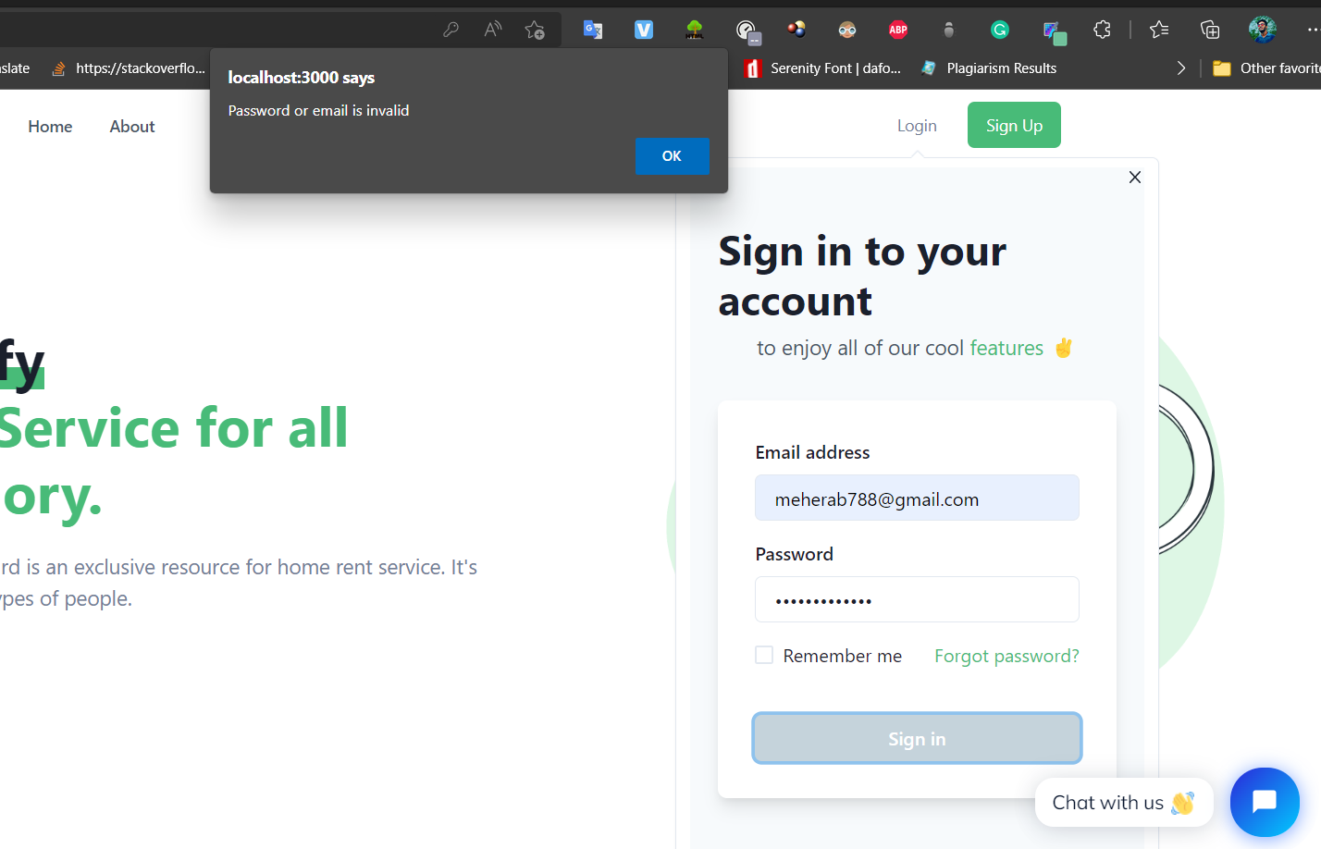
ERROR RECOVERY
- Error alert will pop up
-User can recover their errors

Slide 4
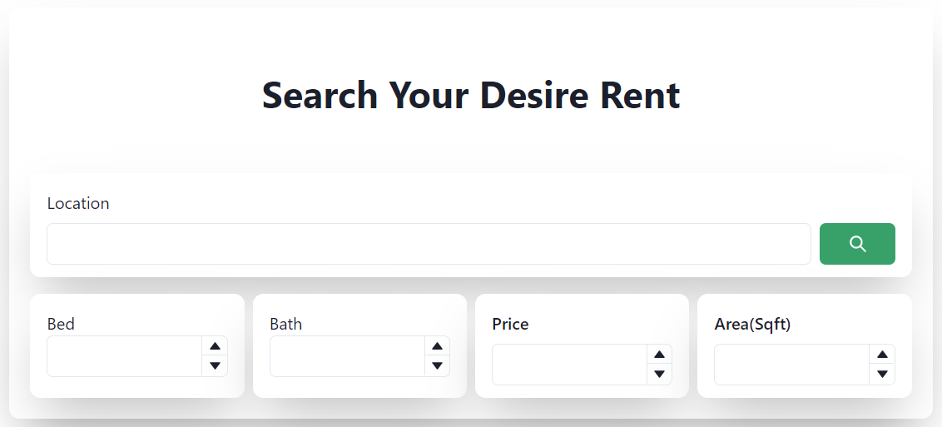
FLEXIBILITY
-User can easily search for rents
-User can filter out specific ads

Slide 5
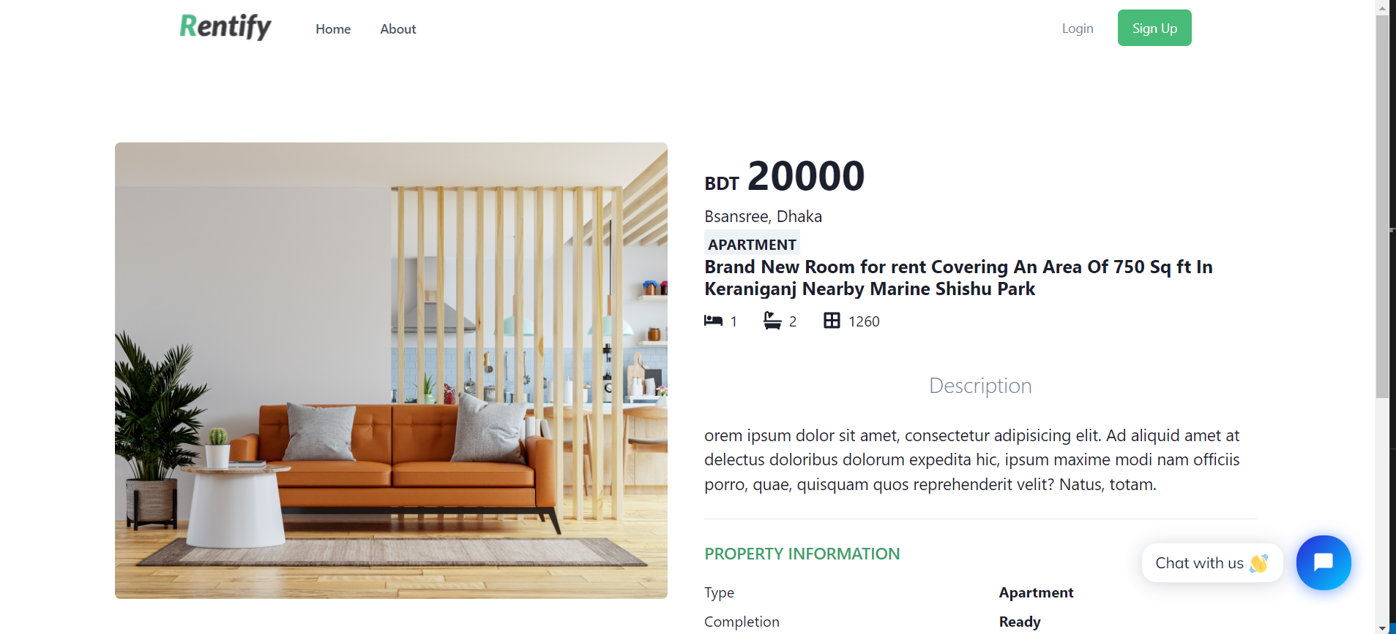
MINIMALISM
-Users can easily get necessary information
-UI looks minimalist and simplistic

Slide 6
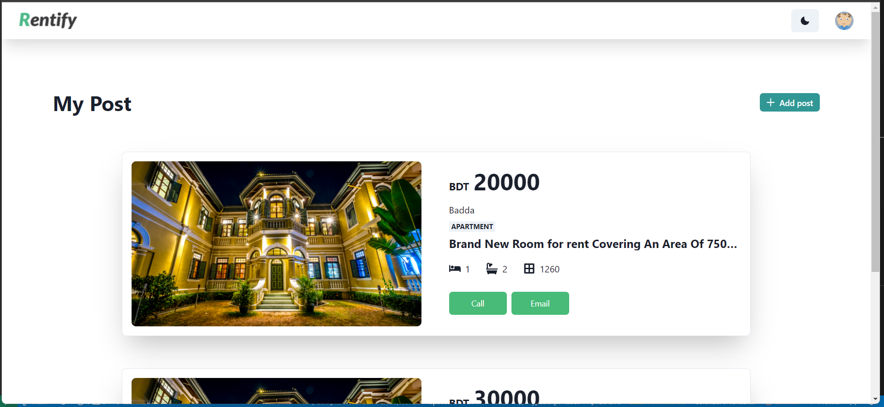
RECOGNITION
-User can easily discover their posts
-User can add, update and delete post

